Slide 1
Digital Transmission

Slide 2
4-2 ANALOG-TO-DIGITAL CONVERSION
Topics discussed in this section:
Pulse Code Modulation (PCM)

Slide 3
PCM
steps to digitize an analog signal:
  Sampling
  Quantization
  Binary encoding

Slide 4

Figure 4.21 Components of PCM encoder

Slide 5
Sampling
Analog signal is sampled every T_{S} secs.
T_{s} is sampling interval.
f_{s} = 1/T_{s}
( fs )sampling rate or sampling frequency.

Slide 6
Sampling
3 sampling methods:
  Ideal -
  Natural -
  Flattop -

Slide 7

Figure 4.22 Three different sampling methods for PCM

Slide 8

Note
According to the Nyquist theorem, the sampling rate must be
at least 2 times the highest frequency contained in the signal.

Slide 9

Figure 4.23 Nyquist sampling rate for low-pass and bandpass signals

Slide 10
Quantization
Sampling results in a series of pulses
varying amplitude values
ranging between two limits: a min and a max.
The amplitude values are infinite between the two limits.

Slide 11
map infinite amplitude values
onto finite set of known values.
achieved by dividing the distance
between min and max into L zones,
each of height Δ.
Δ = (max - min)/L

Slide 12
Quantization Levels
The midpoint of each zone is assigned a value from 0 to L-1 (resulting in L values)
Each sample falling in a zone is then approximated to the value of the midpoint.

Slide 13
Quantization Zones
V_{min}=-20V and V_{max}=+20V.
use L=8 quantization levels.
Zone width Δ = (20 - -20)/8 = 5
The 8 zones are:
-20 to -15, -15 to -10, -10 to -5, -5 to 0, 0 to +5, +5 to +10, +10 to +15, +15 to +20
midpoints are: -17.5, -12.5, -7.5, -2.5, 2.5, 7.5, 12.5, 17.5

Slide 14

Figure 4.26 Quantization and encoding of a sampled signal

Slide 15
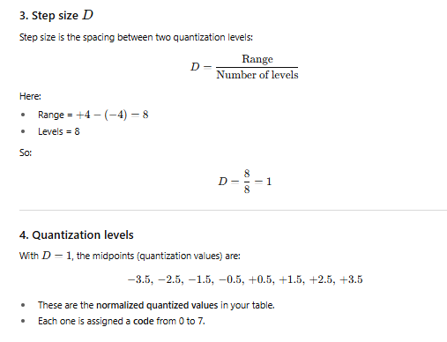

Slide 16
Quantization Error
When a signal is quantized, we introduce an error - the coded signal is an approximation of the actual amplitude value.
The difference between actual and coded value (midpoint) is referred to as the quantization error.
The more zones, the smaller Δ which results in smaller errors.
BUT, the more zones the more bits required to encode the samples -> higher bit rate

Slide 17
Quantization Error and SN_{Q}R
Signals with lower amplitude values will suffer more from quantization error as the error range: Δ/2, is fixed for all signal levels.
Non linear quantization is used to alleviate this problem. Goal is to keep SN_{Q}R fixed for all sample values.
Two approaches:
  The quantization levels follow a logarithmic curve. Smaller Δ’s at lower amplitudes and larger Δ’s at higher amplitudes.
  Companding: The sample values are compressed at the sender into logarithmic zones, and then expanded at the receiver. The zones are fixed in height.

Slide 18
Bit rate and bandwidth requirements of PCM
The bit rate of a PCM signal can be calculated form the number of bits per sample x the sampling rate
Bit rate = n_{b} x f_{s}
The bandwidth required to transmit this signal depends on the type of line encoding used. Refer to previous section for discussion and formulas.
A digitized signal will always need more bandwidth than the original analog signal. Price we pay for robustness and other features of digital transmission.

